Slide 1

Sports India
A Major Project Work
Submitted in 7th Semester of Bachelor of Technology (B. Tech)
In
Computer Science & Engineering (Session: 2017-2021)
Under the Guidance of
Prof. SHITANSHU SONANKIYA
Submitted By Submitted to
Prof. Nitin Shukla
Ritik-0228CS171032 Head of Dept.
DEPARTMENT OF COMPUTER SCIENCE & ENGINEERING
Shri ram Institute of Technology, Jabalpur (M.P.)
Rajiv Gandhi Proudyogiki Vishwavidyalaya, Bhopal (M.P.)

Slide 2

Sports India
Fit India Hit India

Slide 3
Problem Statement
Project Name- Sports India
Problem Statement- Lack of awareness in youth for sports
Team Leader- Ritik Patel
Category- Software
Members Name- Ritik Patel

Slide 4
System Requirements
Windows 10
Tomacat9.0
My SQL 8.0
Java SE 10 or higher version

Slide 5

Introduction

Slide 6
What is sports ?
Sports is an activity who improve us physically and mentally.
Sport is all forms of usually physical activity aim to use, maintain or improve physical ability and skills while providing entertainment to participants, and in some cases, spectators.
Playing sports help in strengthening the immune system, maintaining physical coordination, enhancing body strength and improving mental power. Playing sports on regular basis helps in character and health building of any person.

Slide 7
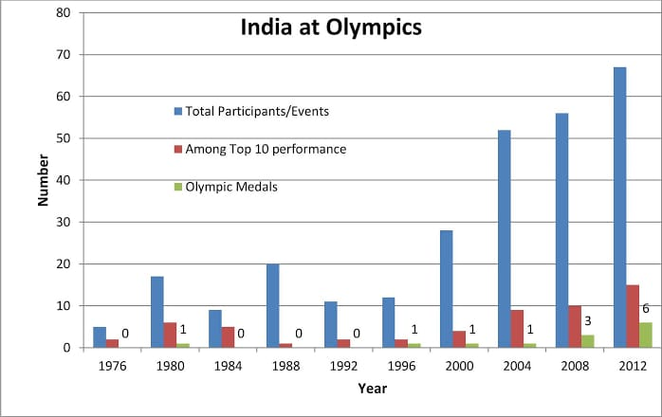

Slide 8
Aim
Spreading awareness among youth about sports.
Creating a new environment for sports in India.
Motivating the youth towards sports

Slide 9
Methodology
Rural areas mostly haven’t aware by health and sports
Most of the child have talent and they only want to a helper who can help them to improve their talent …
So we have an idea to help those student who doesn’t afford the playground ,kit ,fee etc.

Slide 10
Features
Team\ services
Coach
Campaign \ Awareness
Events
Health
Tools Management
Personality development \ Career guidance

Slide 11
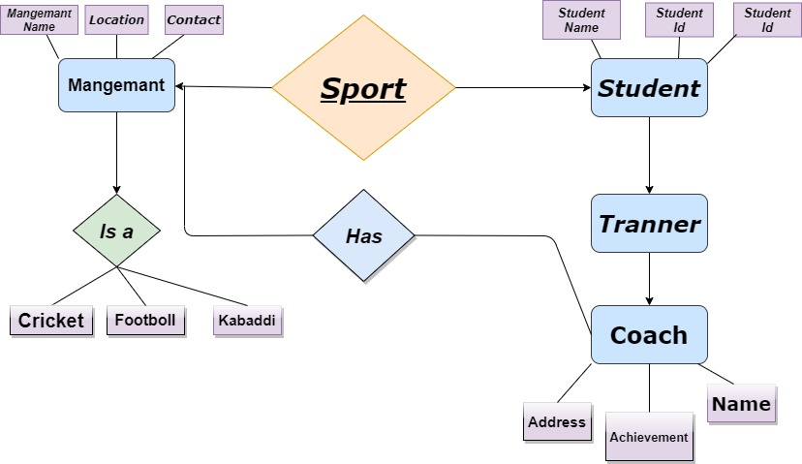
Er Daigram /Working Model

Slide 12
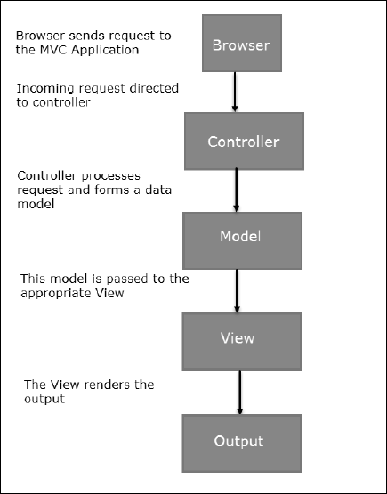
Flow Chart

Slide 13
Future enhancement
Ruler area facing malnutrition
Education career guidance
Sport activity
Self-defence
Awareness for health

Slide 14
Screenshot

Slide 15
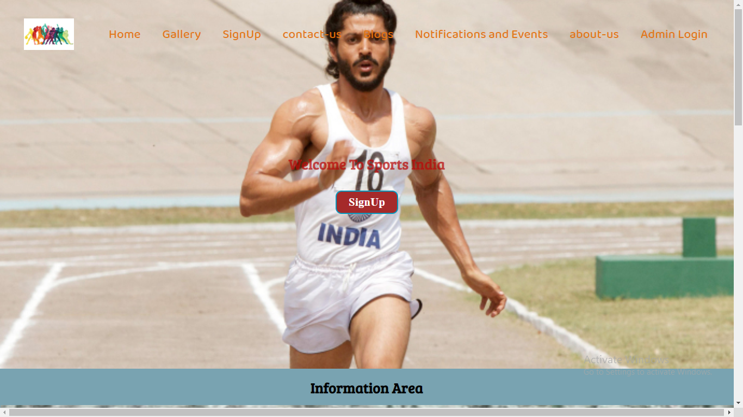

Slide 16
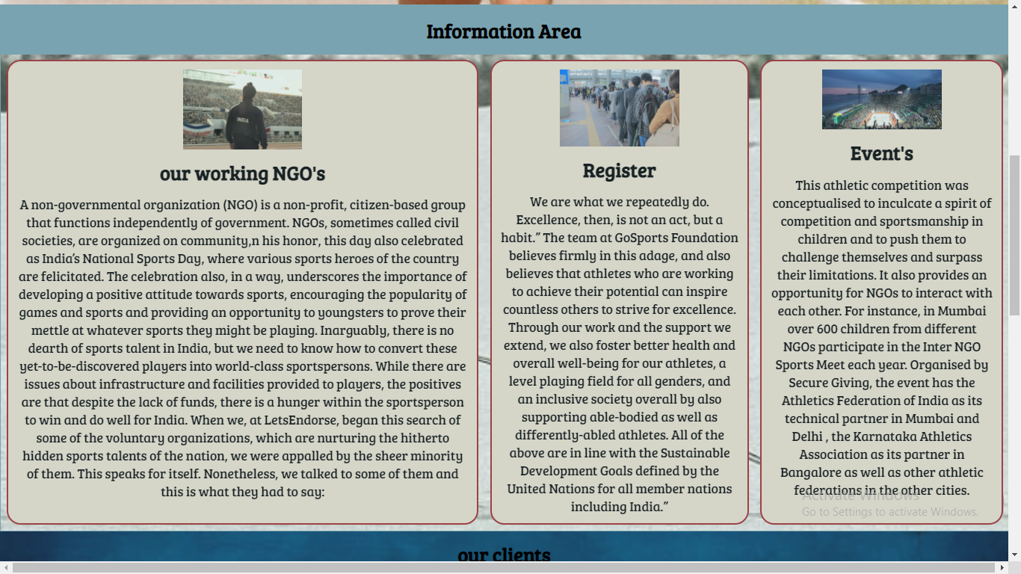

Slide 17
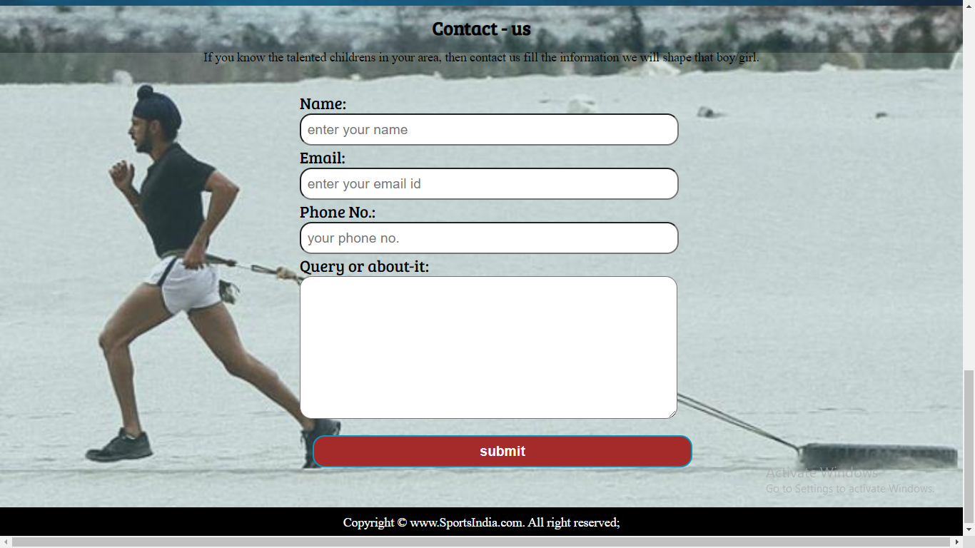

Slide 18
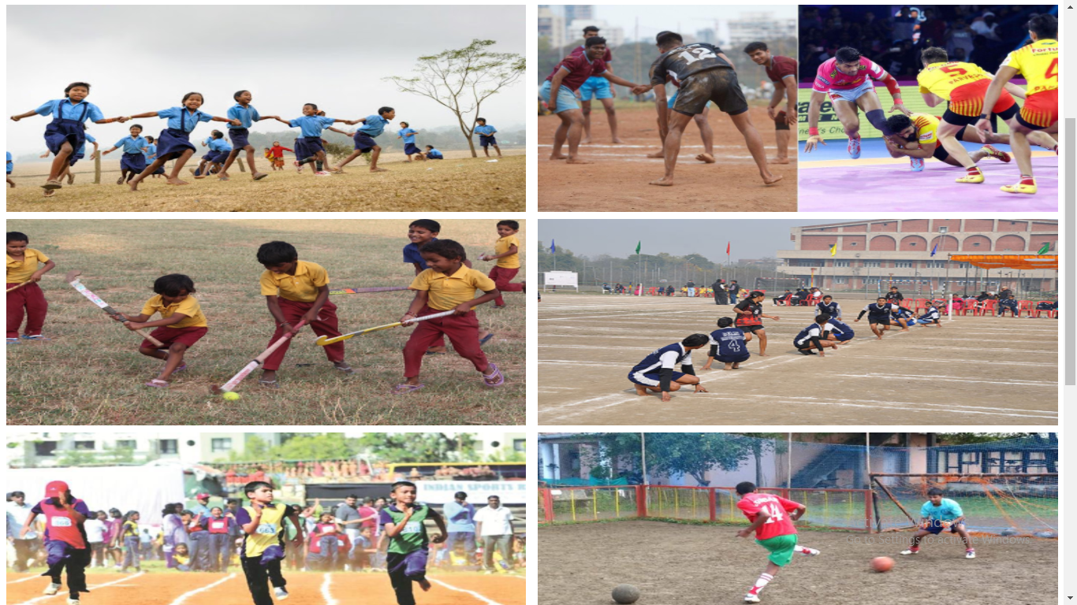

Slide 19
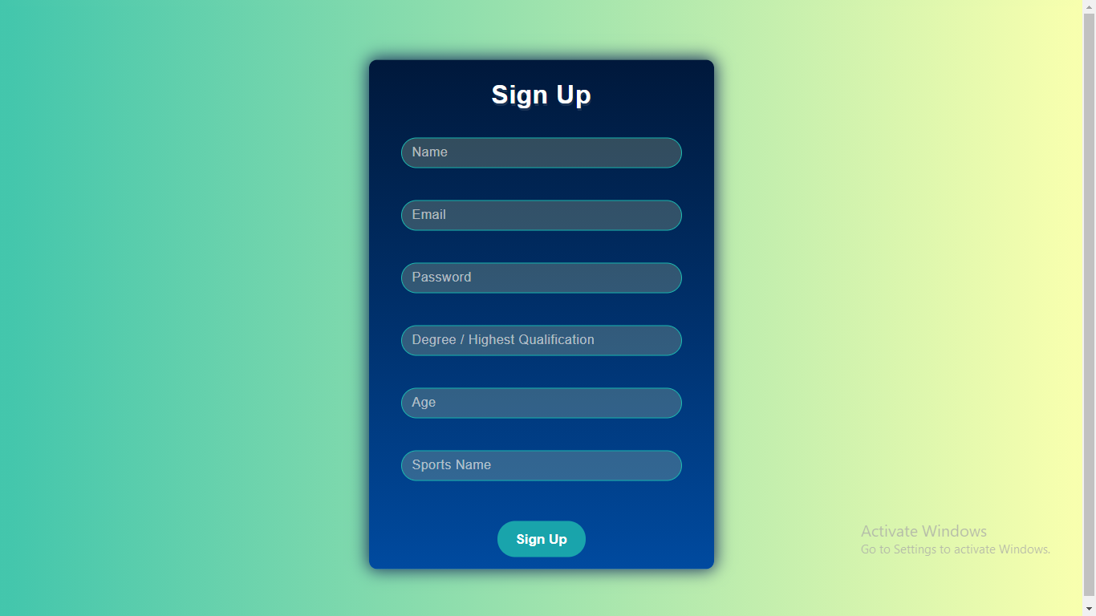

Slide 20
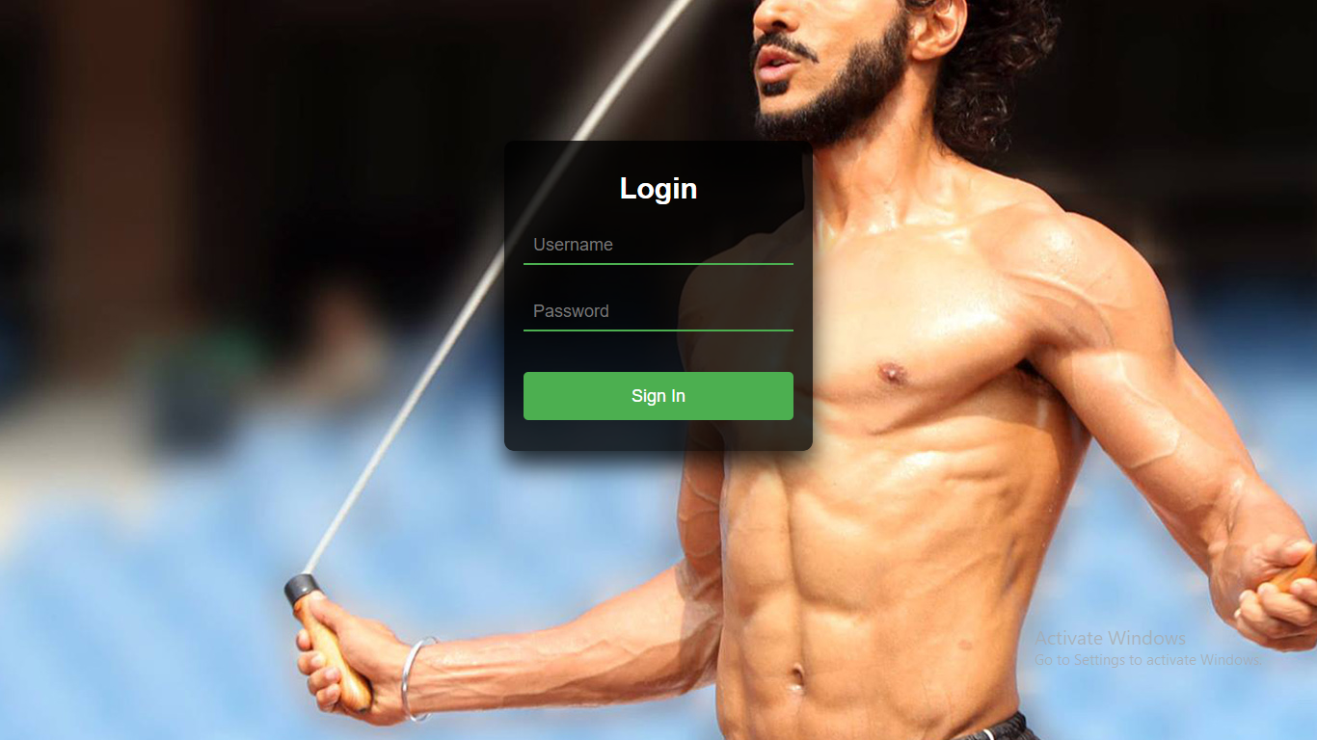

Slide 21
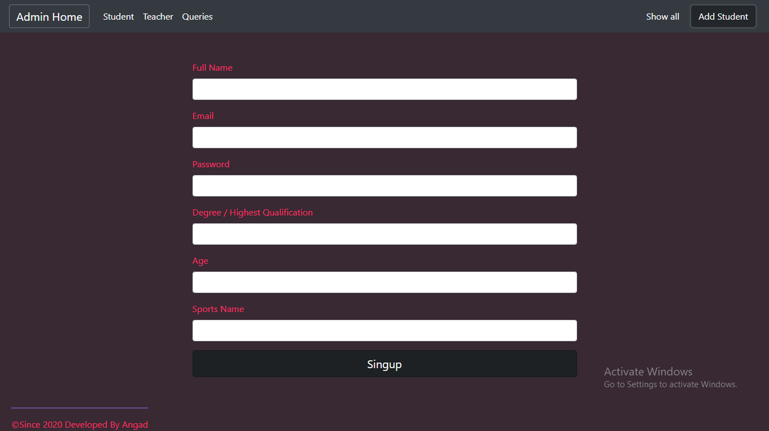

Slide 22
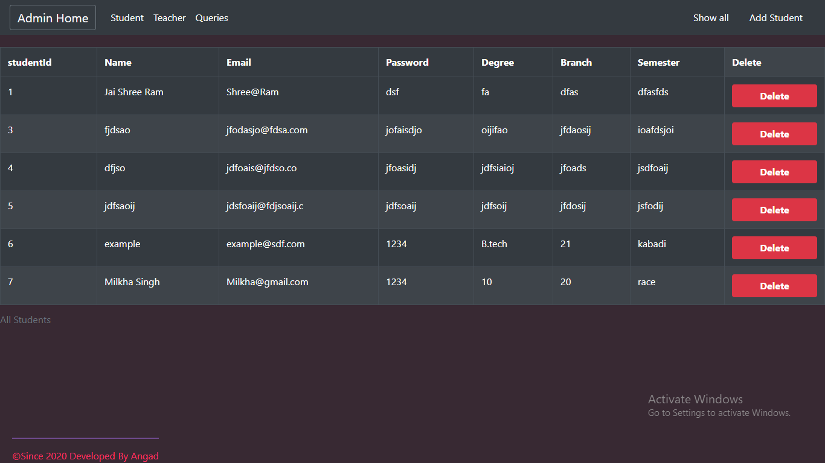

Slide 23
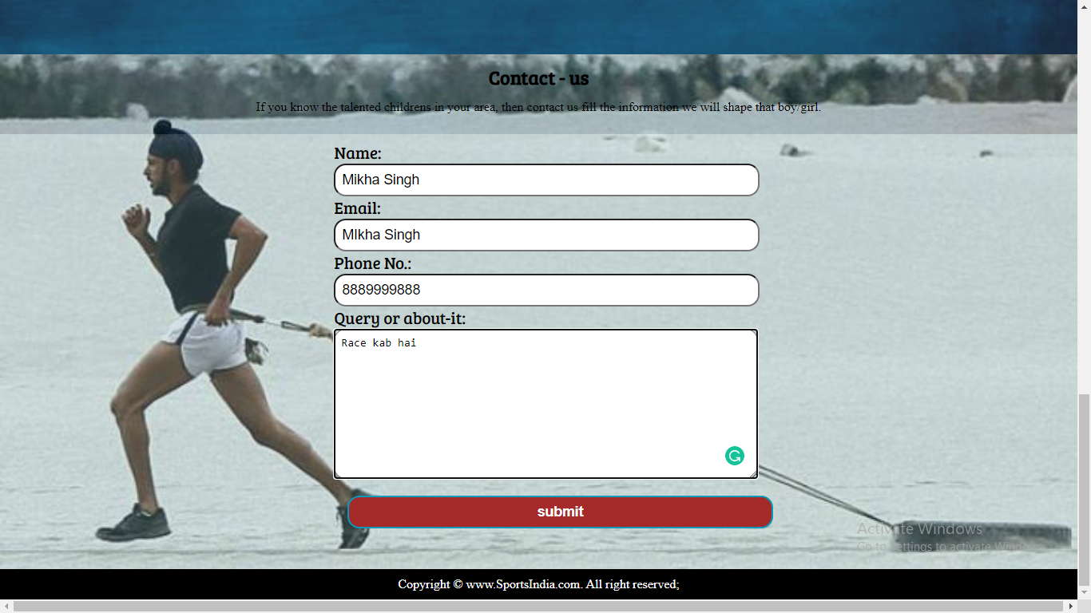

Slide 24
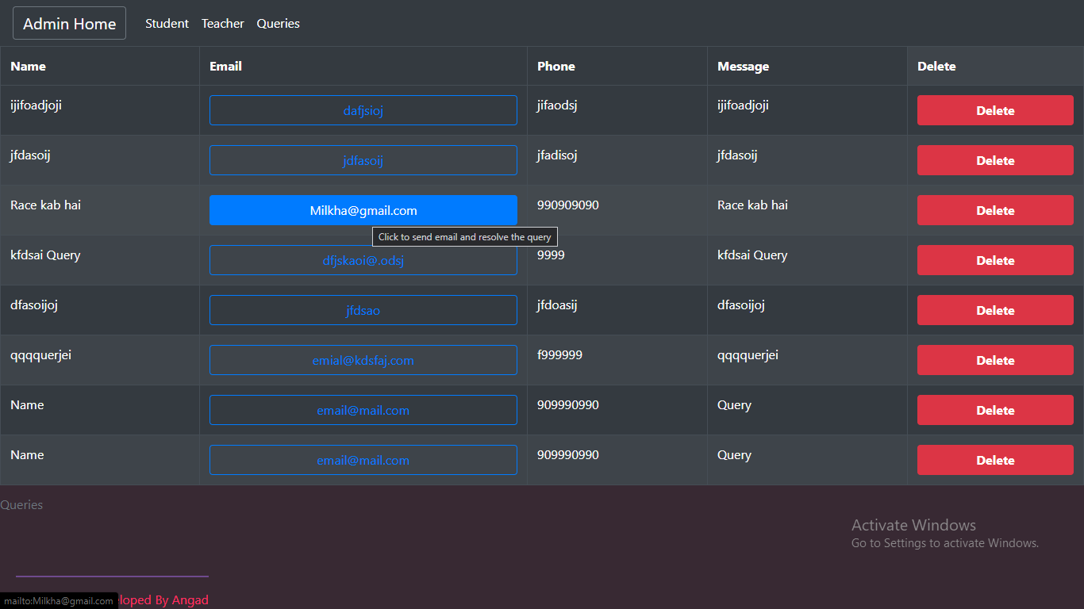

Slide 25

Programming

Slide 26
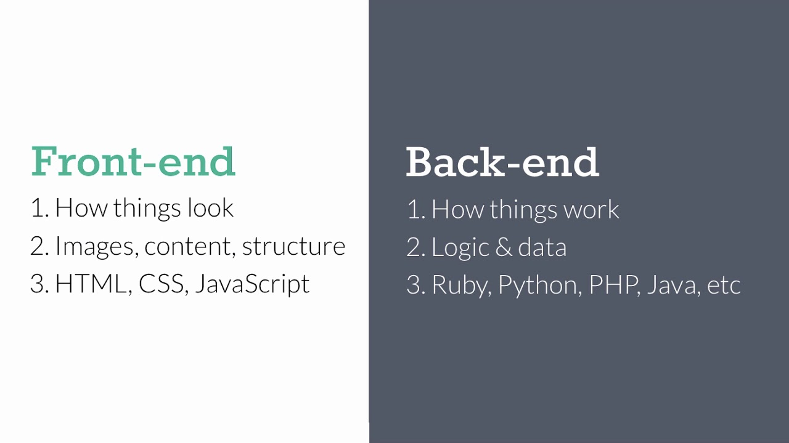

Slide 27
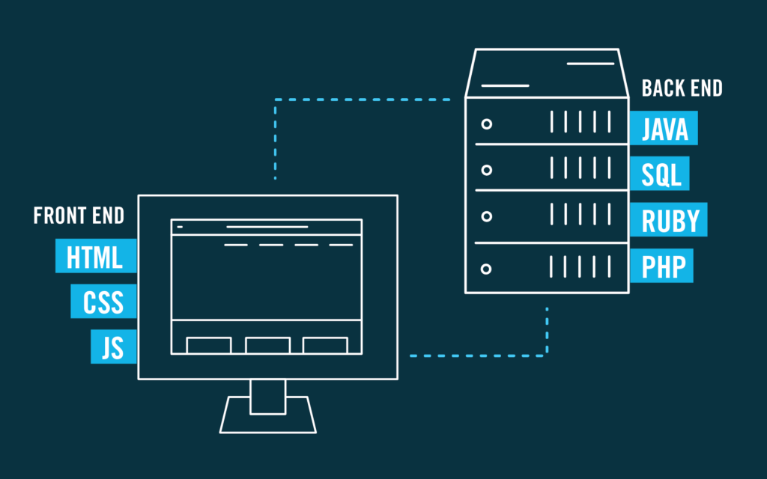

Slide 28
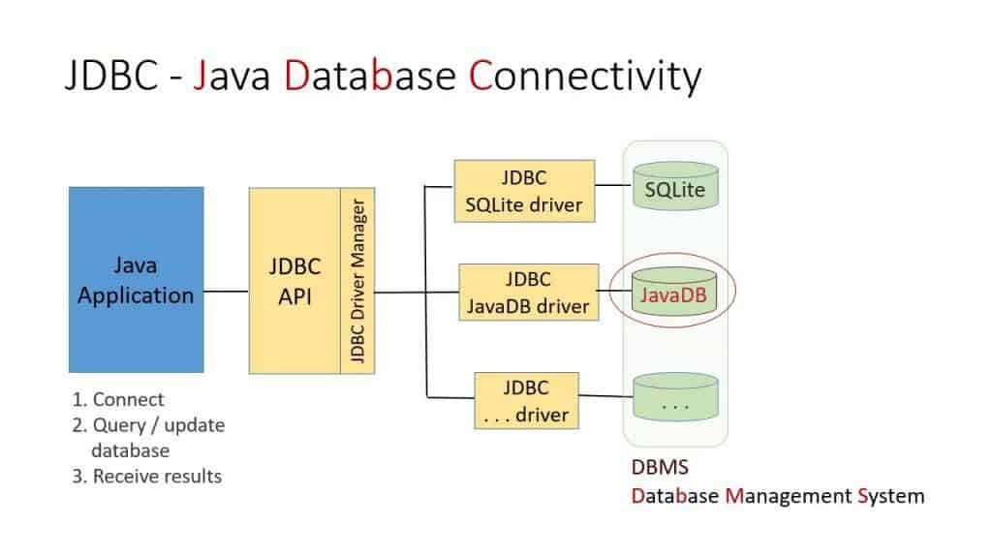

Slide 29
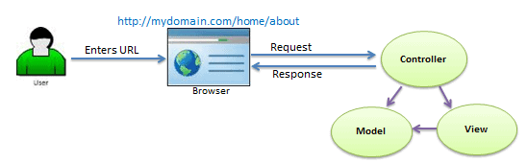

Slide 30
Query Thank you....!

